Slide 1

COMP7500 Advanced Operating Systems
Interprocess Communication
Dr. Xiao Qin
Auburn University http://www.eng.auburn.edu/~xqin
xqin@auburn.edu
Notes:
2019S
02a: 11 Minutes
02b: 41 Minutes Slides 1-14
2018S
02a-Project 1 Overview: 15 Minutes
02b-Interprocess Communication: 35 Minutes Slides 1-12

Slide 2
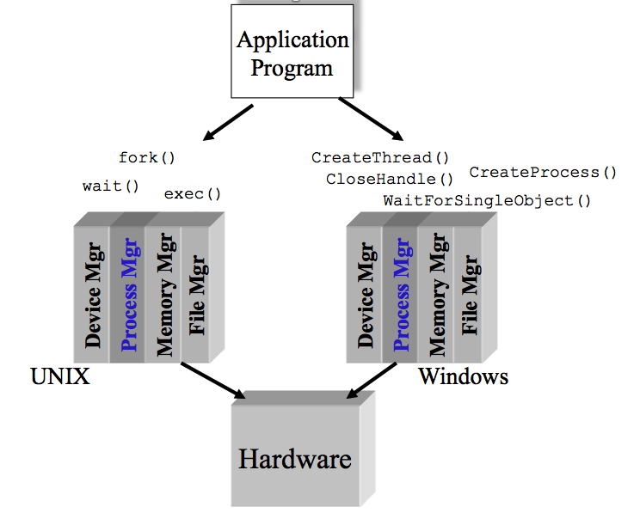
Exercise 1 (Plickers): Which one of the following is not a basic component in Microkernel? (30 seconds)
Process manager
Memory manager
IPC: inter-process communications
File manager
External View of the Process Manager

Slide 3
Exercise 2: (Plickers): Which one of the following items is not a design goal of a process manager? Hint: You should focus on OS management of application execution.
To improve CPU utilization
To switch a processor among multiple processes
To allocate memory resources to processes
To use processor more efficiently

Slide 4
Exercise 3 (Plickers): The context-switch time is OS overhead. The context-switch overhead depends on the following factors except. (30 Seconds)
A. The complexity of the OS and PCB
B. Open source operating systems
C. Multiple sets of registers per CPU
D. Multiple contexts loaded at once.

Slide 5
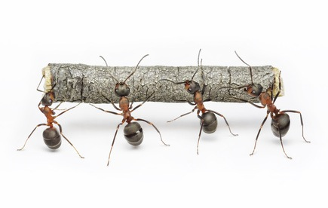
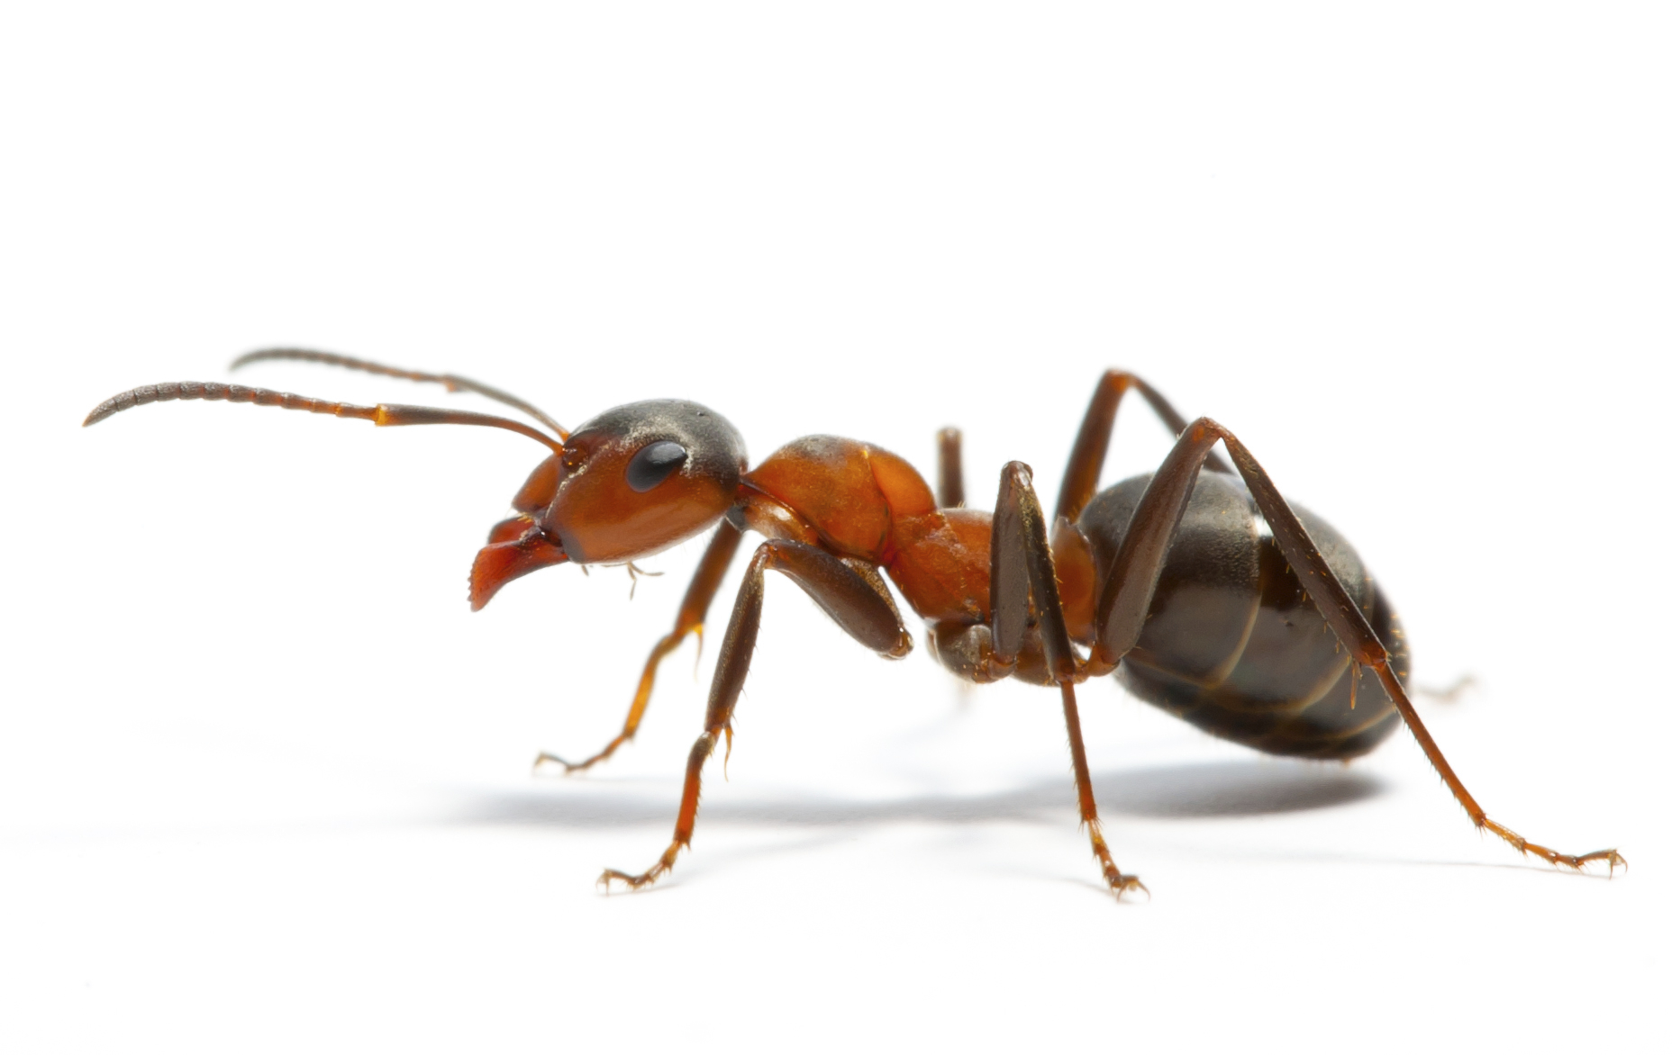
Cooperating Processes
Independent process cannot affect or be affected by the execution of another process
Cooperating process can affect or be affected by the execution of another process

Slide 6




Exercise 4. What are advantages of process cooperation?
Information sharing
Computation speed-up
Modularity
Convenience

Slide 7
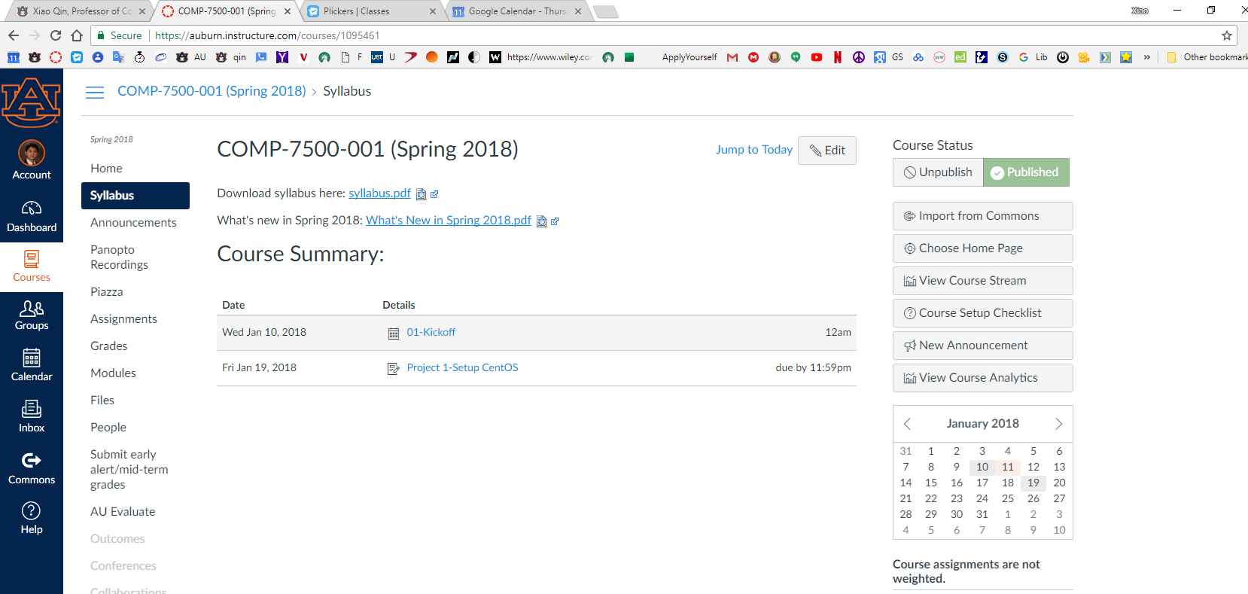
Exercise 5: Google Chrome Browser Design
What can be a potential problem if all the four tabs are running in a single process?
Notes:
In Chrome, each and every tab you open gets its own content process. Ten tabs, 10 processes. One hundred tabs, 100 processes.
https://en.wikipedia.org/wiki/Tab_(GUI)
The WordVision DOS word processor for the IBM PC in 1982 was perhaps the first commercially available product with a tabbed interface. PC Magazine in 1994 wrote that it "has served as a free R&D department for the software business—its bones picked over for a decade by programmers looking for so-called new ideas".^{[2]} The NeWS version of UniPress's Gosling Emacs text editor was another early product, with multiple tabbed windows in 1988.^{[3]} It was used to develop an authoring tool for the Ben Shneiderman's HyperTIES browser (the NeWS workstation version of The Interactive Encyclopedia System), in 1988.^{[4][5]} HyperTIES also supported pie menus for managing windows and browsing hypermedia documents with PostScript applets. Don Hopkins developed and released several versions of tabbed window frames for the NeWS window system as free software, which the window manager applied to all NeWS applications, and enabled users to drag the tabs around to any edge of the window.^{[6]}
HyperTIES was a "hypermedia" browser, a term first used by Ted Nelson in 1965. The first "web" browser came out later in 1990,^{[7]} and the term "World Wide Web" was not invented until 1990.^{[8]}
In 1992 Borland's Quattro Pro popularized tabs for spreadsheets; Microsoft Word in 1993 used them to simplify submenus.^{[2]} In 1994, BookLink Technologies featured tabbed windows in its InternetWorks browser. That same year, the text editor UltraEdit also appeared with a modern multi-row tabbed interface. The tabbed interface approach was then followed by the Internet Explorer shell NetCaptor in 1997. These were followed by a number of others like IBrowse in 1999, and Opera in 2000 (with the release of version 4 - although a MDI interface was supported before then), MultiViews October 2000, which changed its name into MultiZilla on 1 April 2001 (an extension for the Mozilla Application Suite^{[9]}), Galeon in early 2001, Mozilla 0.9.5 in October 2001, Phoenix 0.1 (now Mozilla Firefox) in October 2002, Konqueror 3.1 in January 2003, and Safari in 2003. With the release of Internet Explorer 7 in 2006, all major web browsers featured a tabbed interface.
Users have quickly adopted the use of tabs in web browsing and web search. A study of tabbed browsing behavior in June 2009 found that users switched tabs in 57% of tab sessions, and 36% of users used new tabs to open search engine results at least once during that period.^{[10]}
Numerous special functions in association with browser tabs have emerged since then. One example is visual tabbed browsing in OmniWeb version 5, which displays preview images of pages in a drawer to the left or right of the main browser window. Another feature is the ability to re-order tabs and to bookmark all of the webpages opened in tab panes in a given window in a group or bookmark folder (as well as the ability to reopen all of them at the same time). Links can most often be opened in several modes, using different user interface options and commands:
in a new main window
in the same main window and tab panel
in the same main window and a new tab panel, which is instantly activated
in the same main window and a new tab panel, which remains in the background until the user switches to it.
There are minor usability issues such as whether a new tab opens in the end of the tab list or next to its "parent". For example, Internet Explorer marks tab families with different colours.

Slide 8
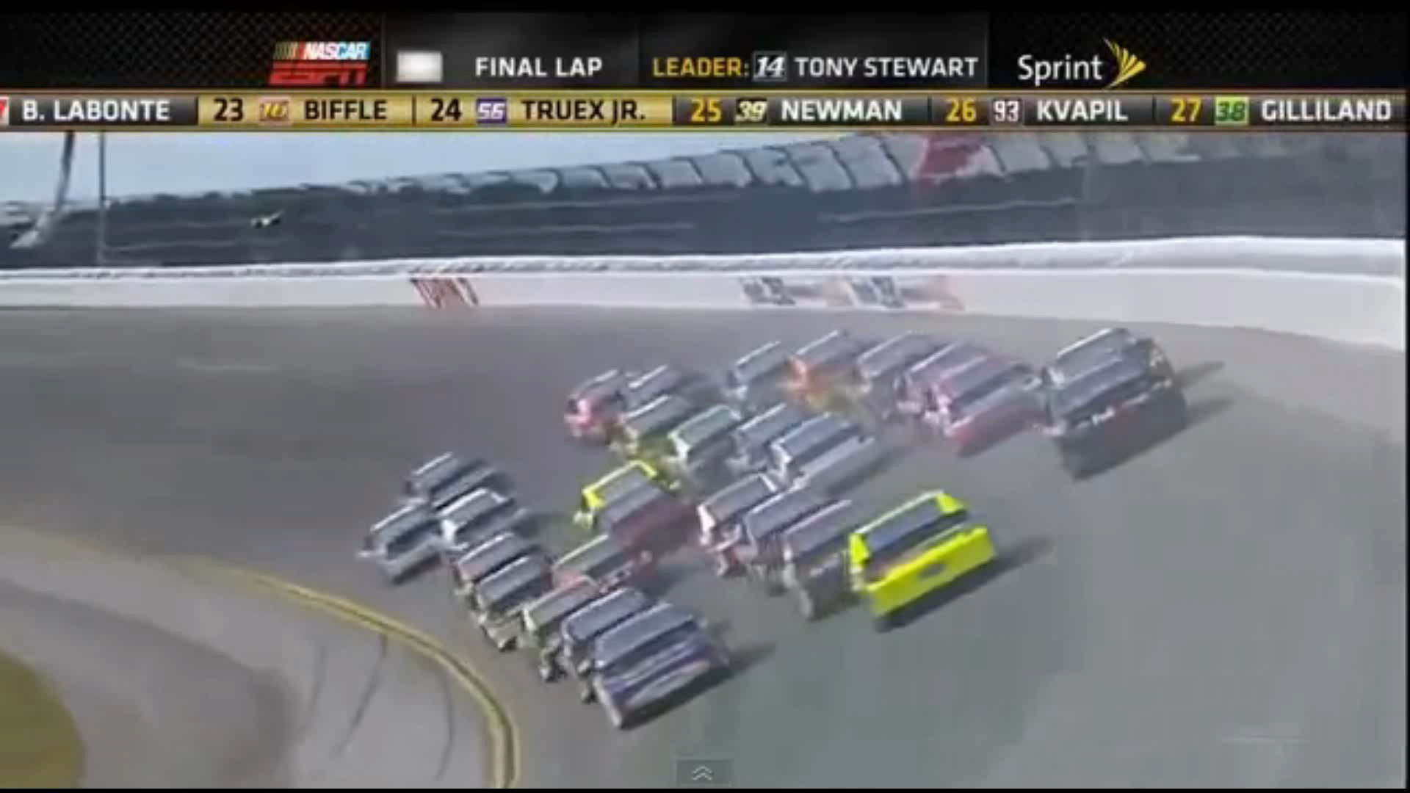

Slide 9
Exercise 6. Can you design a multiprocess architecture to solve problem described in Exercise 5? (Hint: There are three types of cooperating processes)
(1) Browser: user interface, disk, network I/O.
(2) Renderer: logic for rendering web pages: HTML, Javascript, images
(3) Plug-in: e.g., Flash or QuickTime

Slide 10
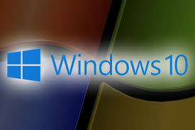
IPC Mechanisms in Windows

Slide 11
IPC Mechanisms in Linux
Signals
Anonymous Pipes
Named Pipes or FIFOs
SysV Message Queues
POSIX Message Queues
SysV Shared memory
POSIX Shared memory
SysV semaphores
POSIX semaphores
FUTEX locks
File-backed and anonymous shared memory using mmap
UNIX Domain Sockets
Netlink Sockets
Network Sockets
Inotify mechanisms
FUSE subsystem
D-Bus subsystem
Notes:
Unix Domain Sockets: less overhead than IP sockets (i.e. no inter-machine comms) but same convenience otherwise.

Slide 12

Exercise 7. What are two fundamental models of interprocess communication?

Slide 13
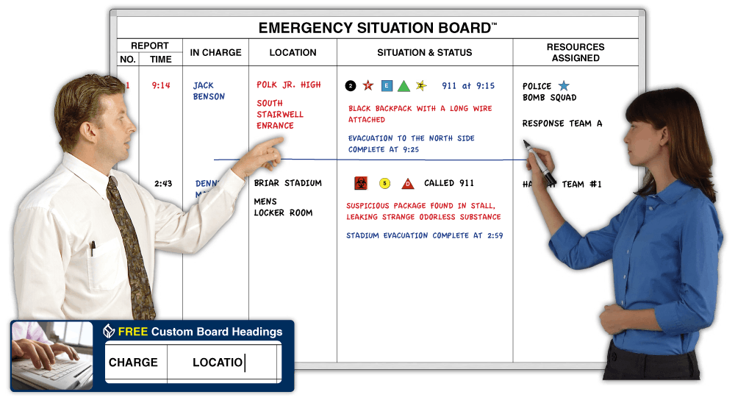
Exercise 7. IPC Model 1: Shared Memory
Notes:
Shared Memory

Slide 14
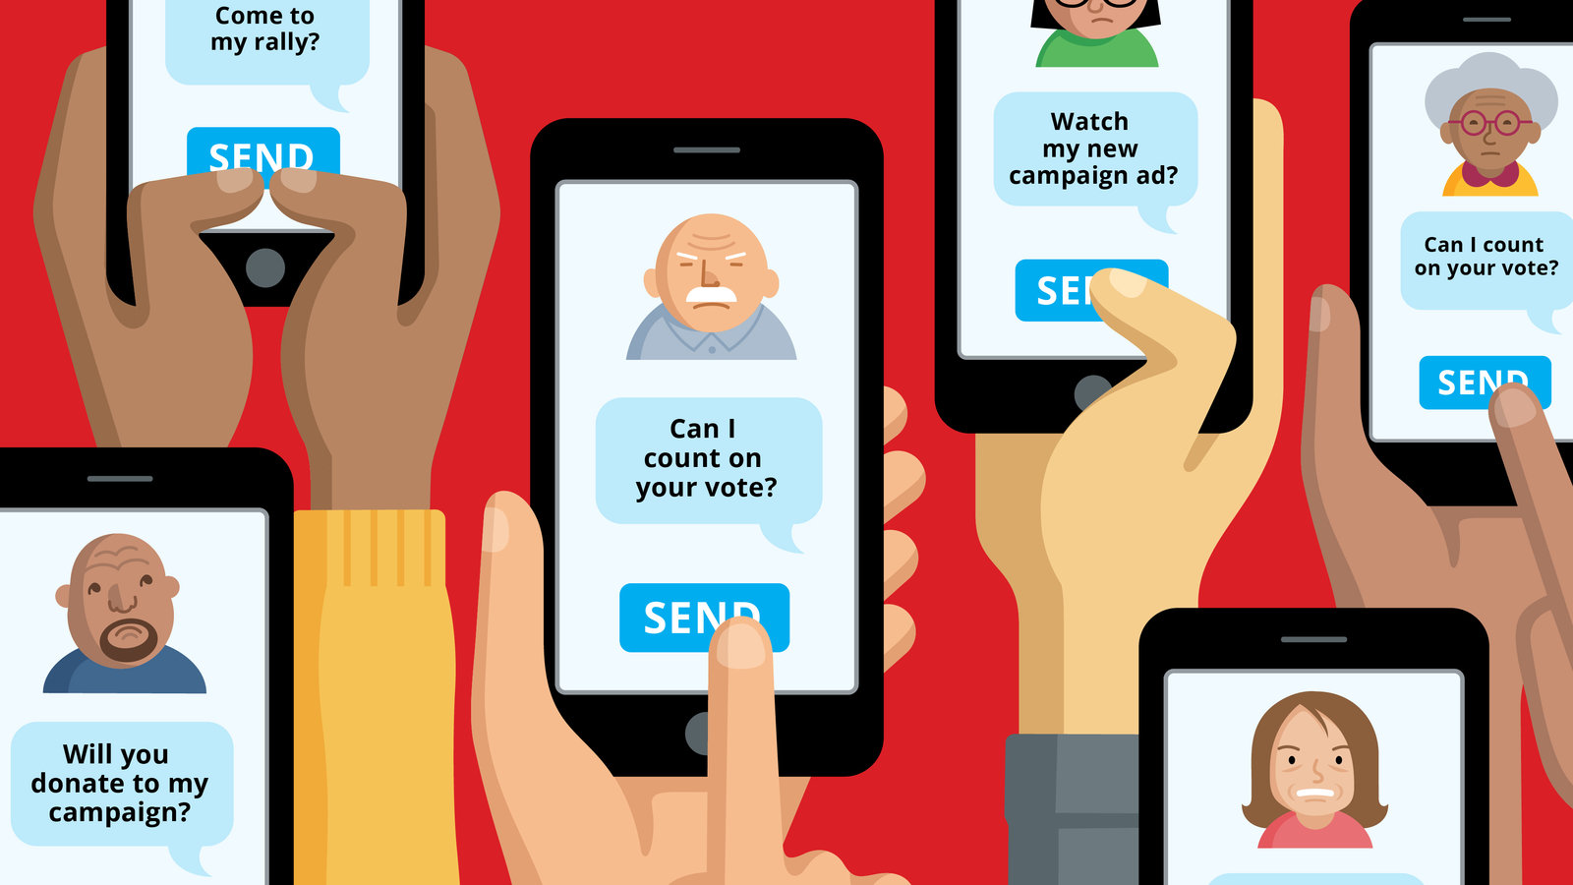
Exercise 7. IPC Model 2: Message Passing
Message Passing
Notes:
Shared Memory

Slide 15
Exercise 8 (Plickers): Suppose two processes are exchange a small amount of data, which interprocess communication model will you choose? Why?
A) Shared Memory
B) Shared Buffer
C) Message Passing
D) None of the above

Slide 16
Exercise 9 (Plickers): Which interprocess communication model is faster than its counterpart? Assumption: message-passing systems are implemented using system calls; shared-memory systems are implemented in the OS kernel.
A) Message Passing is faster B) Shared Memory is faster
C) Shared Message is faster D) Two models are both fast

Slide 17
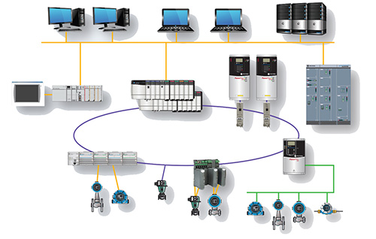
Exercise 10 (Plickers): Which interprocess communication model is easier to implement in a distributed system?
A) Shared Memory is easier B) Message Passing is faster
C) Message Passing is easier D) Two models are equal

Slide 18
Summary
What are advantages of process cooperation?
What is the Google Chrome Browser Design?
What are two fundamental models of interprocess communication?
What are the differences between the shared memory and message passing models?

